Slide 1

MINI PROJECT 03
Customer Complaints Classification
09 OCT 2021
Nadun Basnayake

Slide 2
Business Question
How can we use Customer Complaints Classification to improve customer service?

Slide 3

Background
The Consumer Complaint Database is a collection of complaints about consumer financial products and services that people sent to companies for response.
Complaints are published after the company responds, confirming a commercial relationship with the consumer, or after 15 days, whichever comes first.
Consumer Complaint Database
https://www.kaggle.com/kadhambari/multi-class-text-classification/data
https://www.consumerfinance.gov/data-research/consumer-complaints/

Slide 4
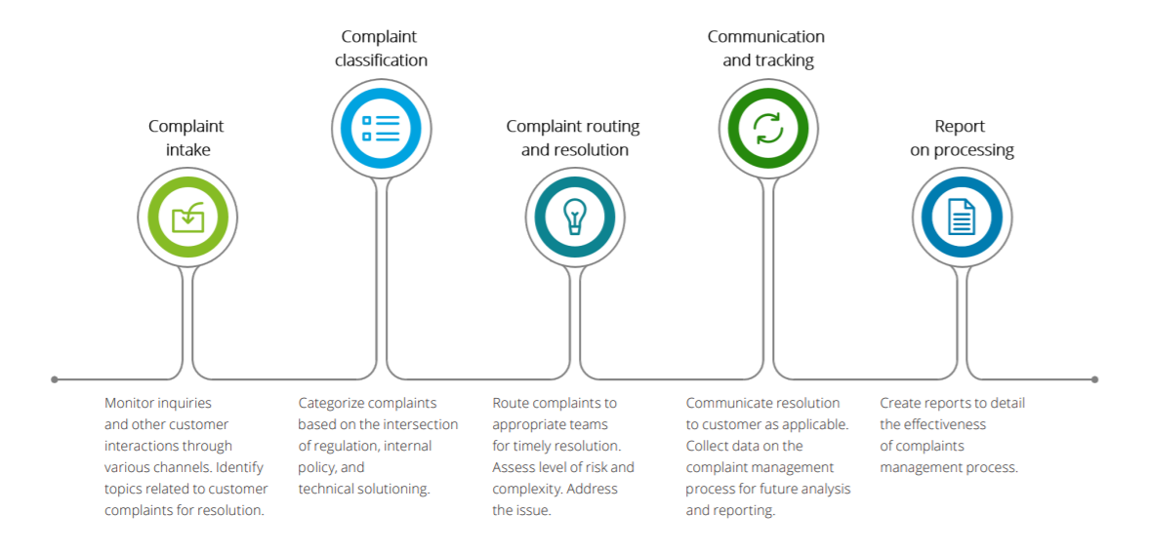
Importance of the Question
Companies have to handle high volumes of complaints through a wide range of channels such as social media.
Significant consumer-centric reforms have happened in the recent times globally creating a lot of competition
Increasing need of new technologies & methodologies (i.e AI / NLP)
Ability to apply to other areas of business, other media (chats, calls)
Sample Customer Complaint Management Lifecycle

Slide 5
Pipeline
Data
Acquisition + Business Question
Exploring & Cleaning
Delivery
Modelling
Tuning & Validate
NLP
Techniques

Slide 6
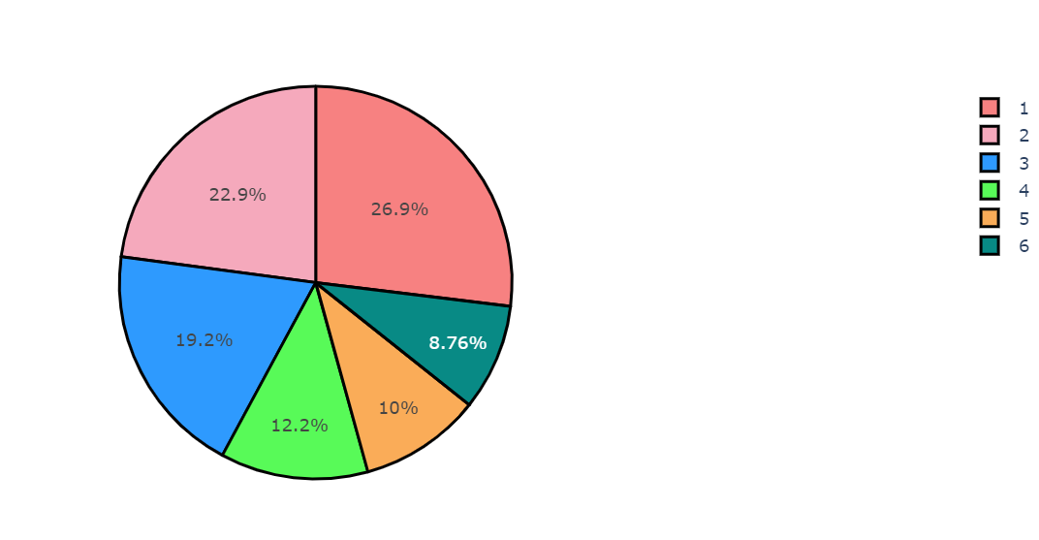
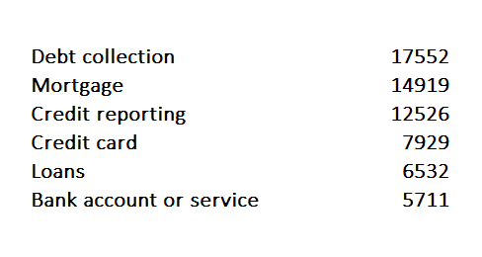
Dataset Summary
US Consumer Financial Protection Bureau
65169 data rows
Used only the Complaints Text data for analysis & modelling
Target Variable: Complaint Type (Multi-class Text Label)

Slide 7
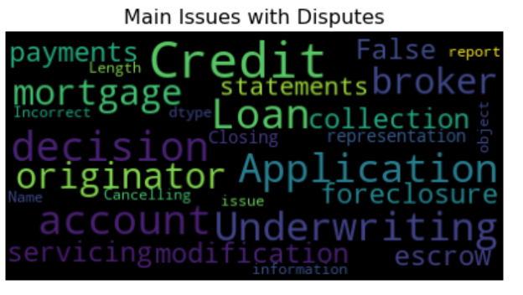
EDA

Slide 8
Pre-processing & Modelling
Vectorized (Count, TF-IDF, N-Gram)
Removed Punctuations, Stop Words, Lemmatized
Modelling
Multinomial Naïve Bayes
Support Vector Machine
Random Forest
Gradient Boosting
XG Boost
Topic Modelling
Sentiment Analysis

Slide 9
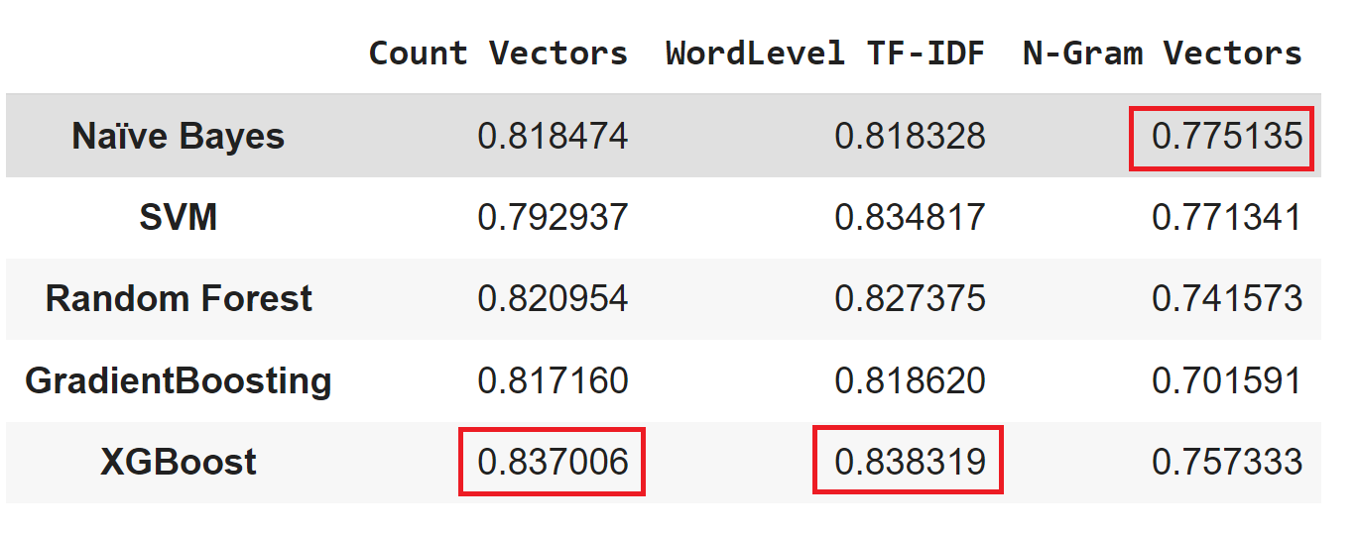
Accuracy
Best Performing: XGB on Word-level TF-IDF

Slide 10
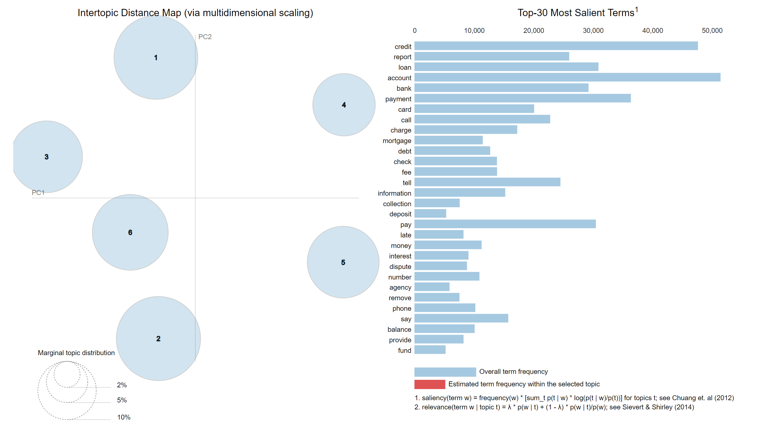
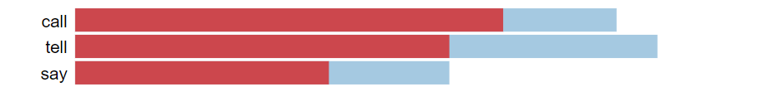
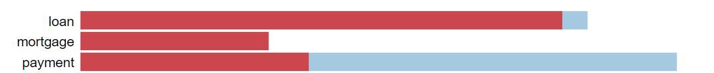
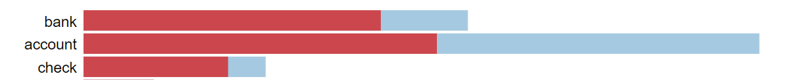
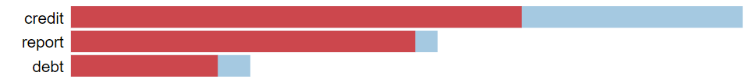
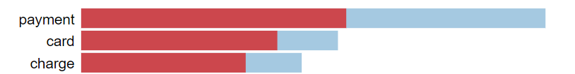
Topic Modelling
Modelled on the entire Dataset with no labels

Slide 11
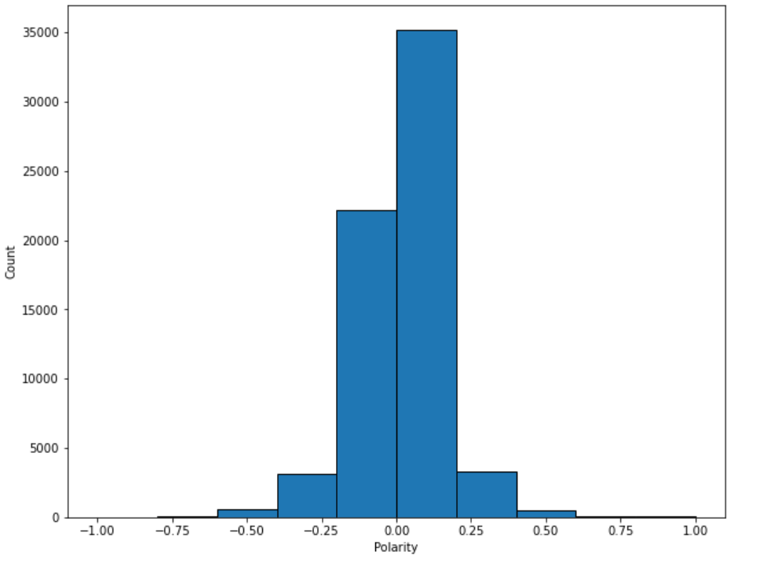
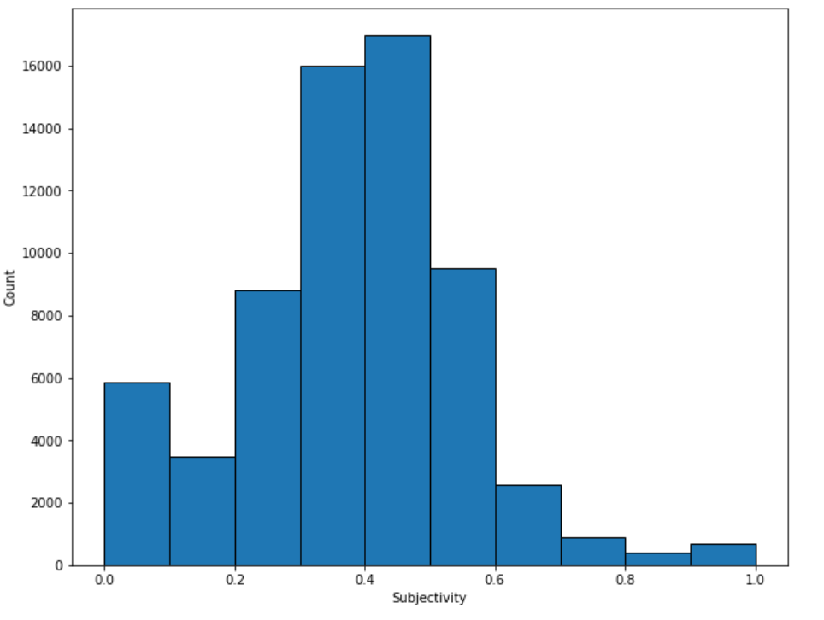
Sentiment Analysis
Polarity is float which lies in the Range [-1 = Negative, 1 = Positive]
Subjective sentences refer to personal opinion, emotion or judgment whereas objective refers to factual information. Range: [0,1]

Slide 12
Findings & Discussion
We can predict customer complaints category with an accuracy upto 83%
This confirms modelling can be used to direct customers to provide a better service – reducing delays, identifying the problem correctly
Using Term-Frequency at word level yields the best results.
Topic modelling can also be used to categorize when labelled data are unavailable – this needs to be combined with domain expertise.
Sentiment analysis helps distinguish between customer dissatisfaction and a formal complaint – majority of the complaints are formal complaints.

Slide 13
Model Recommendations & Improvements
Further Improve accuracy using Deep Learning techniques (ex- LSTM)
Using additional features for modelling (Company, Sub-Issue, Location, Date, Submitted Mode)
Using above features analyze within each sub-group (i.e Company)
Text Summarization for longer messages

Slide 14
Questions?
Thank you!

